Slide 1


Slide 2

Introduction & Installation
Ibrahim M.D (Bauchi R user Group)

Slide 3
R Programming
R is a programming language and free software environment for statistical computing and graphics.
Supported by the R Foundation for Statistical Computing.
R language is widely used among statisticians and data miners for developing statistical software and data analysis.

Slide 4
Created by:
George Ross Ihaka is a New Zealand statistician.
Robert Gentleman is a Canadian statistician.

Slide 5
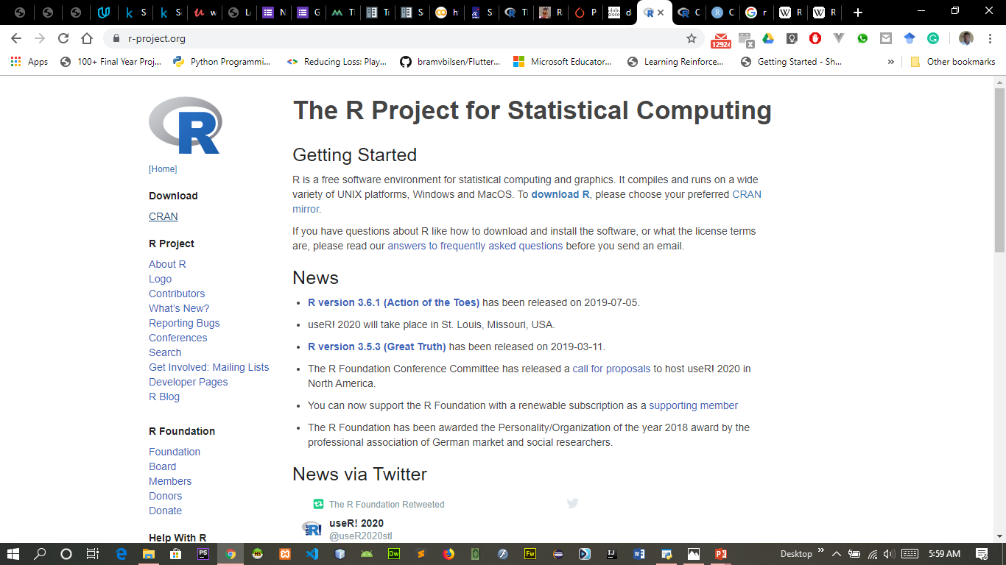
Where to Find the Software
I googled “R project” to find www.r-project.org
The home page looks a little something like this.
I then went to download and installed on windows.
I hope Apple and Linux are just as easy to install

Slide 6
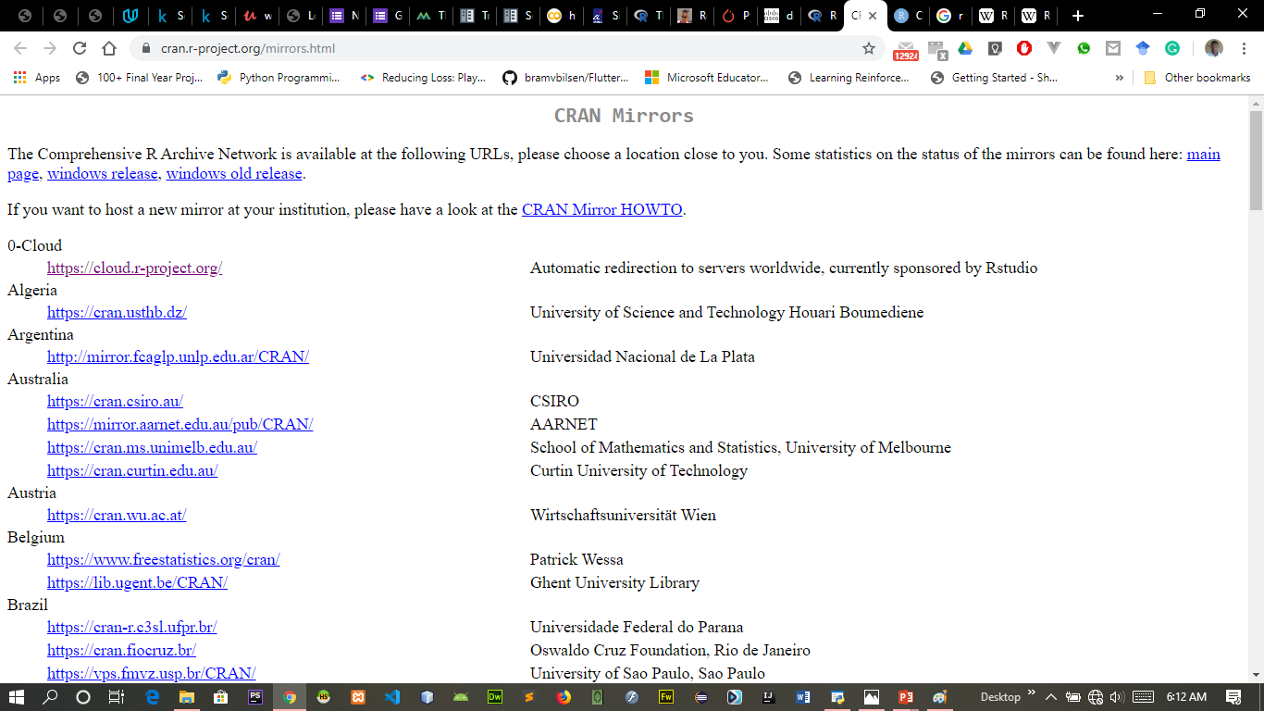
CRAN
The home page looks a little something like this.
Please choose a location close to you.
[Cloud] Automatic redirection to servers worldwide.

Slide 7
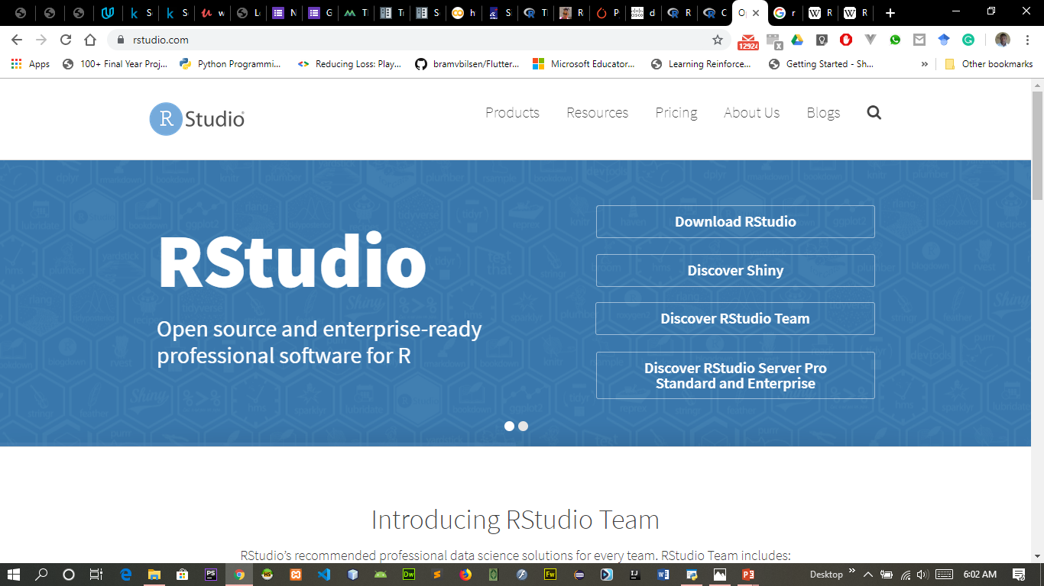
IDE
I googled “R studio” to find https://www.rstudio.com/
The company Rstudio has a free product called “rstudio.”
So I downloaded that as well. (I chose the free open source desktop version)
I also created a shortcut on my desktop.

Slide 8
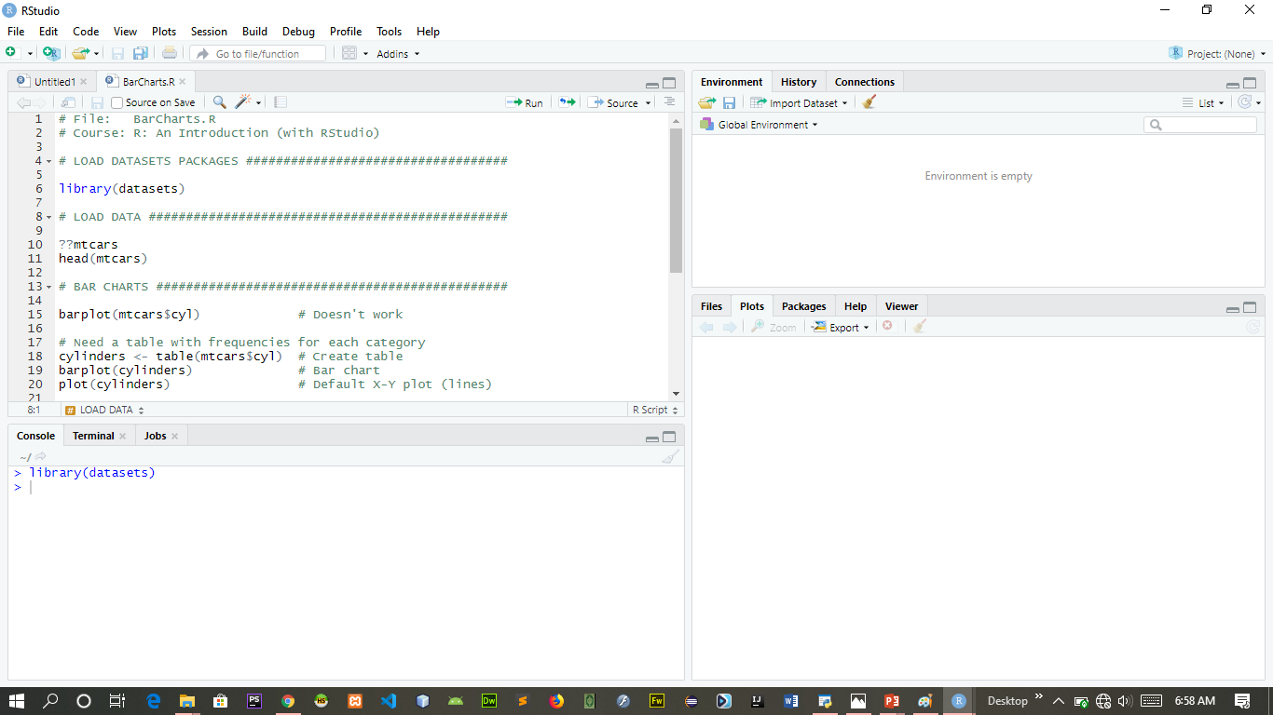
R Studio

Slide 9
variables
numeric
> a = 49
> sqrt(a)
[1] 7
> a = "The dog ate my homework"
> sub("dog","cat",a)
[1] "The cat ate my homework“
> a = (1+1==3)
> a
[1] FALSE
character string
logical

Slide 10
vectors, matrices and arrays
vector: an ordered collection of data of the same type
> a = c(1,2,3)
> a*2
[1] 2 4 6

Slide 11
vectors, matrices and arrays
matrix: a rectangular table of data of the same type
example: the expression values for 10000 genes for 30 tissue biopsies: a matrix with 10000 rows and 30 columns.
array: 3-,4-,..dimensional matrix

Slide 12
Lists
vector: an ordered collection of data of the same type.
> a = c(7,5,1)
> a[2]
[1] 5
list: an ordered collection of data of arbitrary types.
> x= list(name="john",age=28,married=F)
> doe$name
[1] "john“
> doe$age
[1] 28
Typically, vector elements are accessed by their index (an integer), list elements by their name (a character string). But both types support both access methods.

Slide 13
Data frames
Data frame: is supposed to represent the typical data table that researchers come up with – like a spreadsheet.
It is a rectangular table with rows and columns; data within each column has the same type (e.g. number, text, logical), but different columns may have different types.
Example:
> a
sn states distance size
1 Bauchi 6.3 200
2 Gombe 8.0 120
3 Yobe 10.0 400

Slide 14
Some links
https://www.r-project.org/
https://cran.r-project.org/mirrors.html
https://www.rstudio.com/

Slide 15
Contact
https://www.meetup.com/Bauchi-R-User-Group-BauchiRUG/
https://twitter.com/bauchirug

Slide 16


